Slide 1

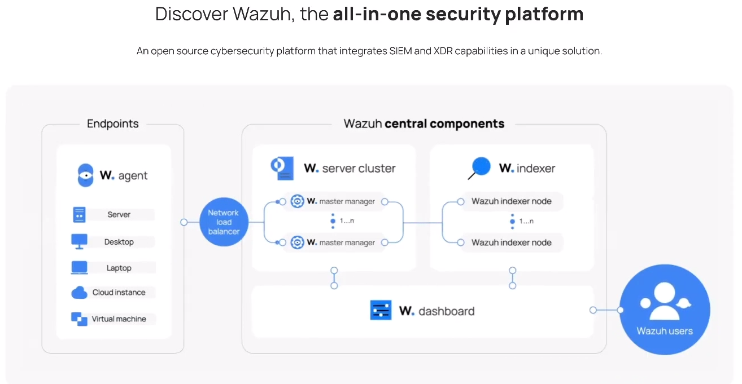

Setup Wazuh v4.14.3
Docker + install-script method for Ubuntu 22.04
Read more information: https://wazuh.com/
Thien.dinh （丁德善 ）

Slide 2
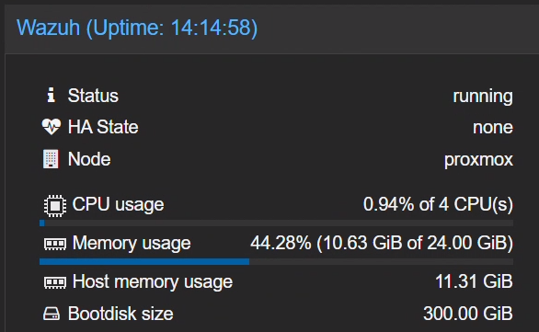
Server Requirements / 系統需求
OS: Ubuntu 22.04
CPU: 4 Cores.
RAM: 16GB (Minimum).
Disk: 500GB or larger.
Read more information: https://wazuh.com/
Thien.dinh （丁德善 ）

Slide 3
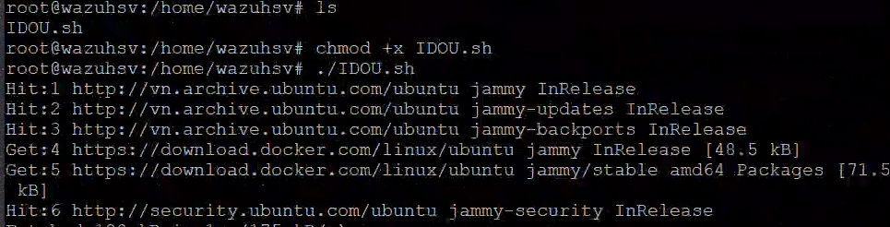
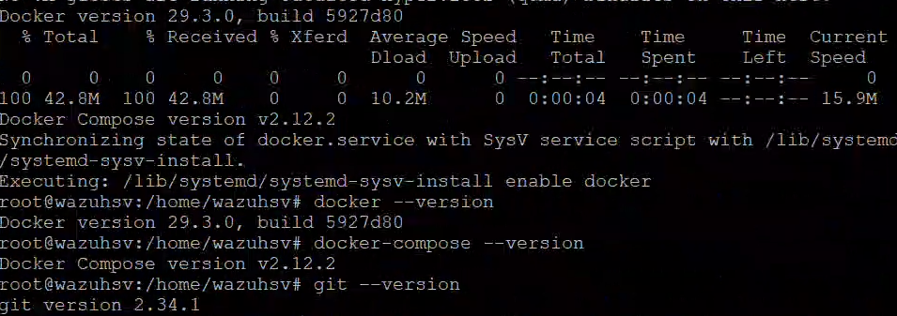

I. Install Docker & docker-compose
1. Download file install.sh
wget https://raw.githubusercontent.com/ddthien-coder/idocker-ubuntu/refs/heads/develop/IDOU.sh
2. Add permission for script and run file

Slide 4
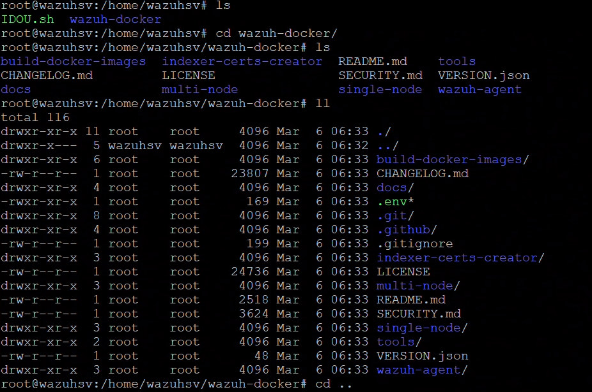
II. Setup and install wazuh
1. Download folder
git clone https://github.com/wazuh/wazuh-docker.git -b v4.14.3

Slide 5
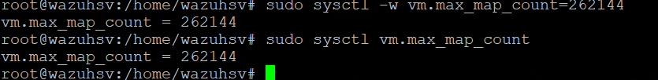
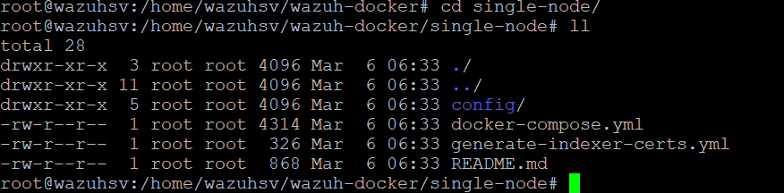
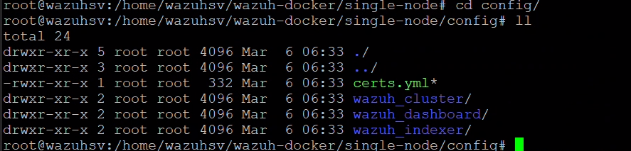
II. Setup and install wazuh
2. Max Map Count
sudo sysctl -w vm.max_map_count=262144
3. Install wazuh single-mode

Slide 6
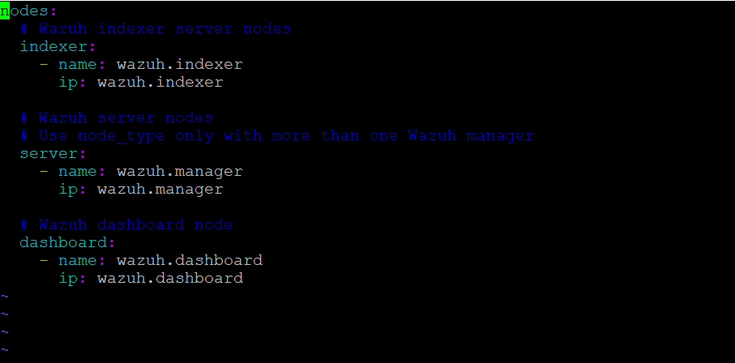
II. Setup and install wazuh
3. Install wazuh single-mode

Slide 7
II. Setup and install wazuh
1. Indexer Node (indexer)
This is the storage and lookup layer.
Name in the image: wazuh.indexer
Role: Like a super-fast librarian. When logs are sent, the Indexer will index them and store them on disk.
Why it's important: When you search for a security event on the web interface, this node will search through its massive data "repository" to return the results to you.
Note: In Docker, the variable ip:wazuh.indexer acts as the internal hostname for other containers to connect to via HTTPS.
2. Server Node (server)
This is the central operating layer (Wazuh Manager).
Name in the image: wazuh.manager
Role: It is the brain of the entire system. It performs the following tasks:
Receives log data sent from Agents (clients).
Analyzes logs based on rulesets to detect attacks.
Issues alerts and pushes them to the Indexer for storage.
Manages the registration and open/closed status of Agents.
Note in the image: The blue text # Use node_type only with more than one Wazuh manager reminds you that if the system grows later and you use a cluster with many Managers, you will need to specify which Node is the Master and which is the Worker.
3. Dashboard Node (dashboard)
This is the user interface layer (GUI).
Name in the image: wazuh.dashboard
Role: It is the face of the system (based on OpenSearch Dashboards). It does not store data but only "draws" data from the Indexer into visual charts, tables, and search bars for you to interact with.
Method: When you log into your browser via port 443, you are interacting directly with this Node.

Slide 8
II. Setup and install wazuh
Summary of the workflow between Nodes: Agent (on your server) $\rightarrow$ sends a log to the server (wazuh.manager). The server analyzes the log $\rightarrow$ detects a threat $\rightarrow$ creates an alert and sends it to the indexer (wazuh.indexer). The indexer stores the alert in the database. You access the dashboard (wazuh.dashboard) $\rightarrow$ The dashboard retrieves data from the indexer and displays it on the screen for you to view.

Slide 9
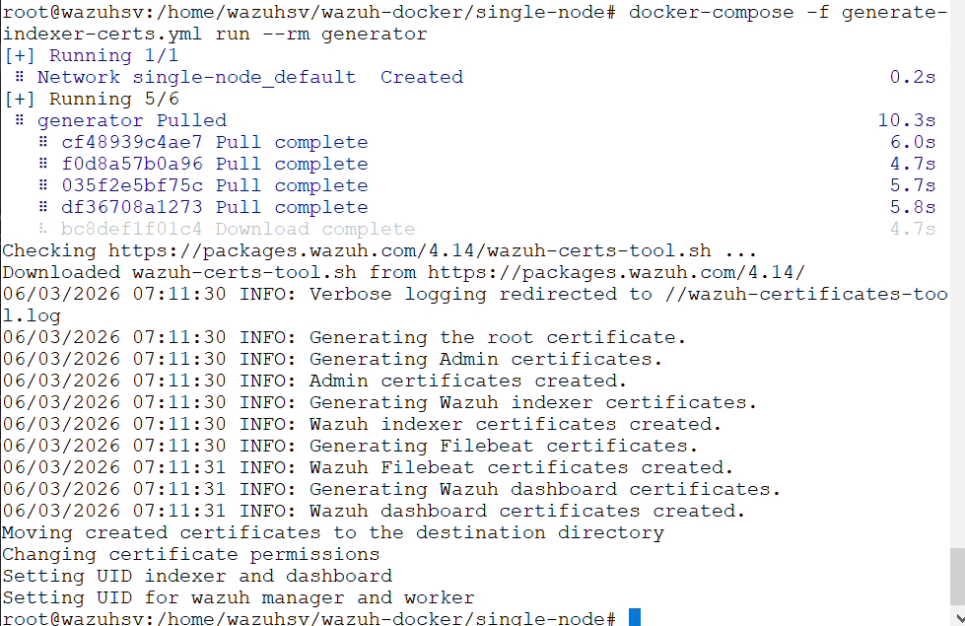
II. Setup and install wazuh
3. Install wazuh single-mode
Create SSL certificates Wazuh requires a secure connection between components
docker-compose -f generate-indexer-certs.yml run --rm generator

Slide 10
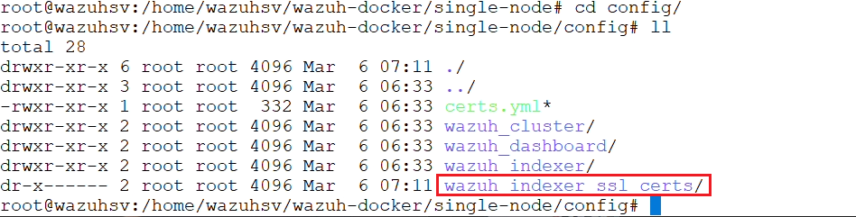
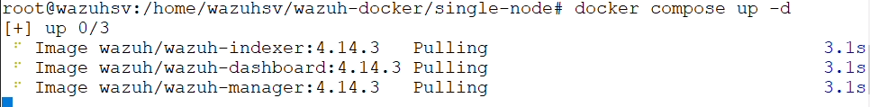
II. Setup and install wazuh
3. Install wazuh single-mode
Create SSL certificates Wazuh requires a secure connection between components
docker-compose -f generate-indexer-certs.yml run --rm generator
4. Start the system
docker compose up -d

Slide 11
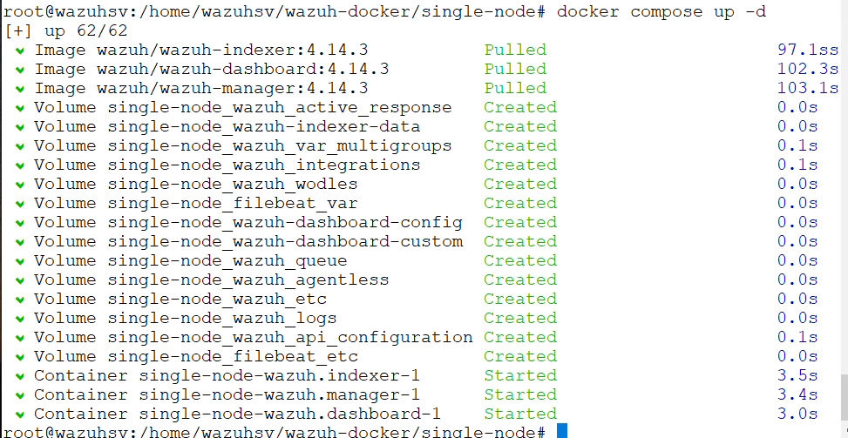
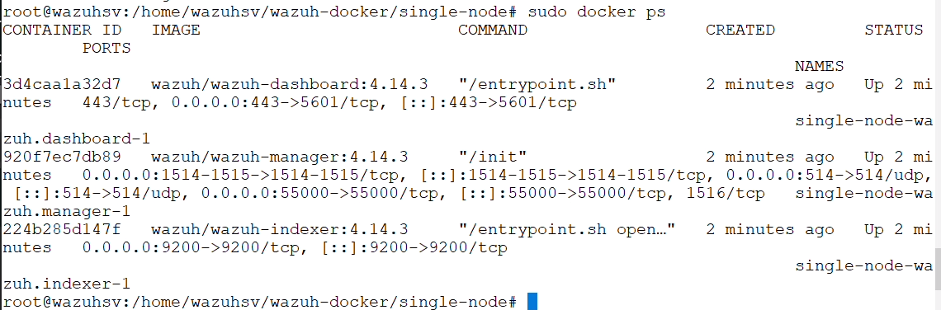
II. Setup and install wazuh
4. Start the system

Slide 12
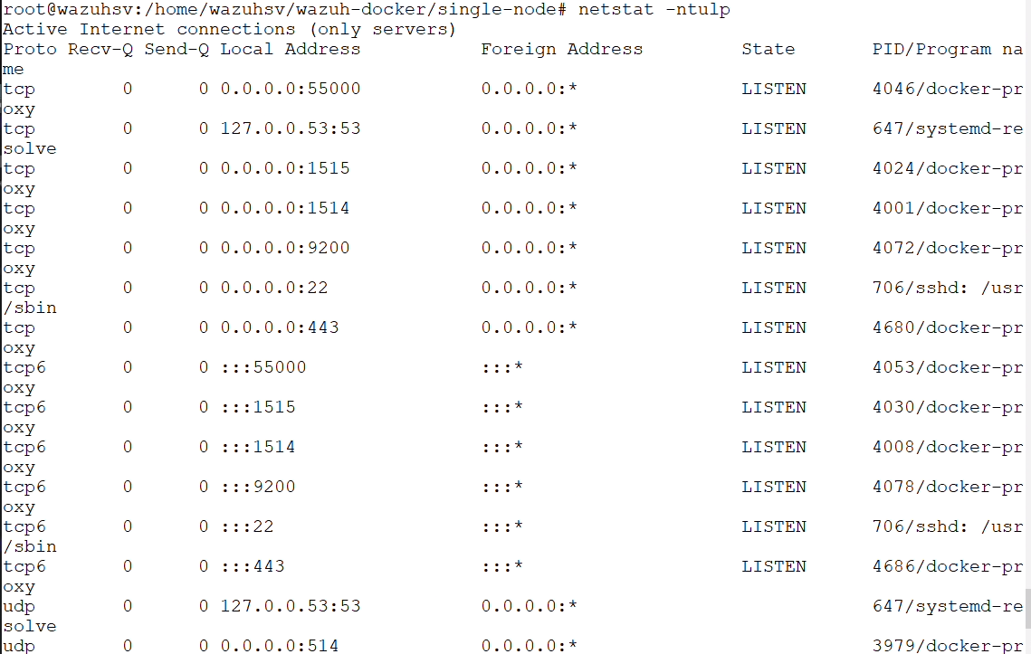
II. Setup and install wazuh
4. Start the system

Slide 13
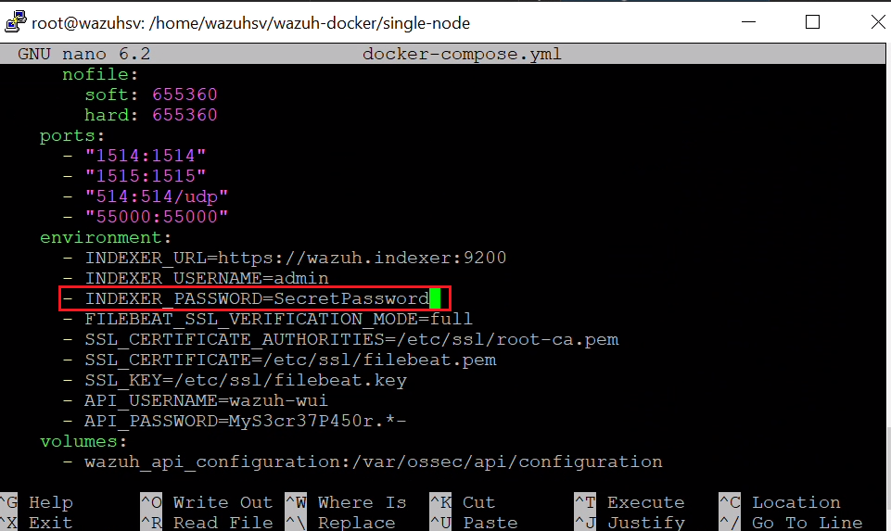
II. Setup and install wazuh
*. Recommend replace new password
https://documentation.wazuh.com/current/deployment-options/docker/changing-default-password.html

Slide 14
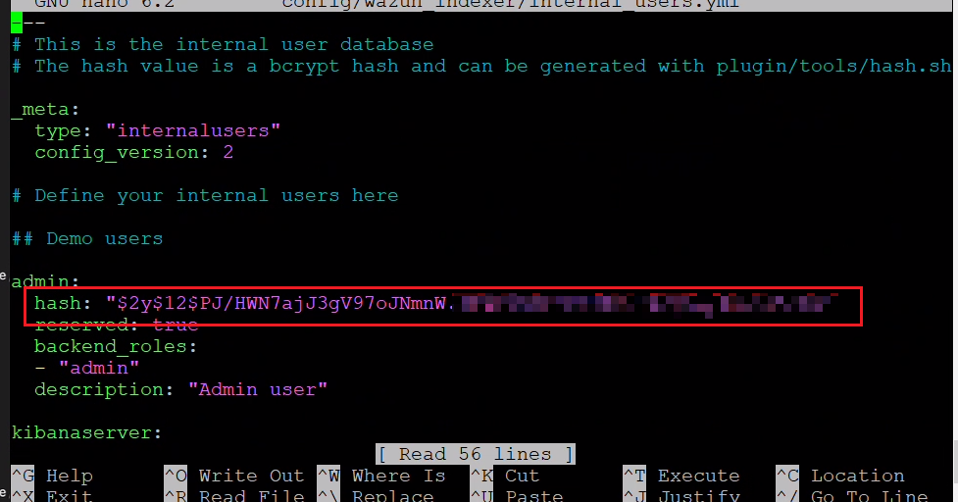
II. Setup and install wazuh
*. Recommend replace new password
https://documentation.wazuh.com/current/deployment-options/docker/changing-default-password.html
nano config/wazuh_indexer/internal_users.yml

Slide 15
II. Setup and install wazuh
*. Recommend replace new password
https://documentation.wazuh.com/current/deployment-options/docker/changing-default-password.html
docker exec -it single-node-wazuh.indexer-1 bash
export INSTALLATION_DIR=/usr/share/wazuh-indexer
export CONFIG_DIR=$INSTALLATION_DIR/config
CACERT=$CONFIG_DIR/certs/root-ca.pem
KEY=$CONFIG_DIR/certs/admin-key.pem
CERT=$CONFIG_DIR/certs/admin.pem
export JAVA_HOME=/usr/share/wazuh-indexer/jdk
bash /usr/share/wazuh-indexer/plugins/opensearch-security/tools/securityadmin.sh -cd $CONFIG_DIR/opensearch-security/ -nhnv -cacert $CACERT -cert $CERT -key $KEY -p 9200 –icl
docker compose down
docker compose up -d

Slide 16
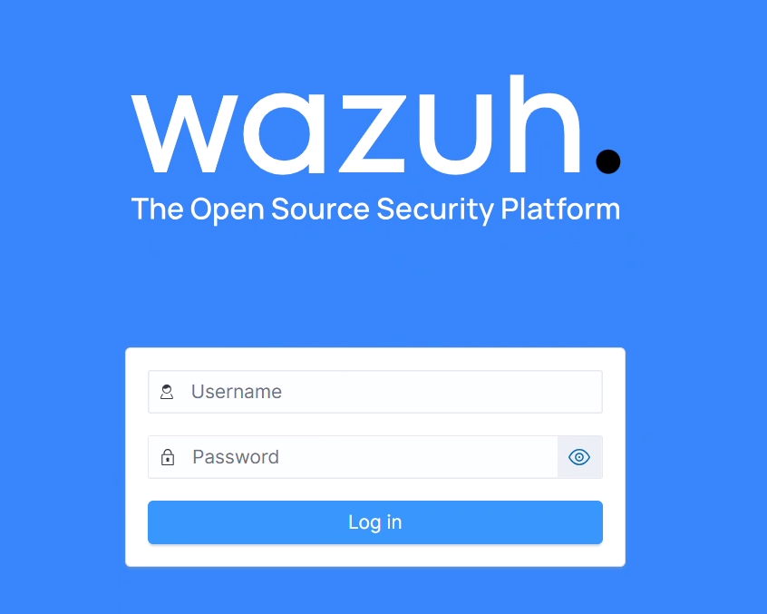
III. Access Wazuh UI
1. Login
User: admin
Password: Your password

Slide 17
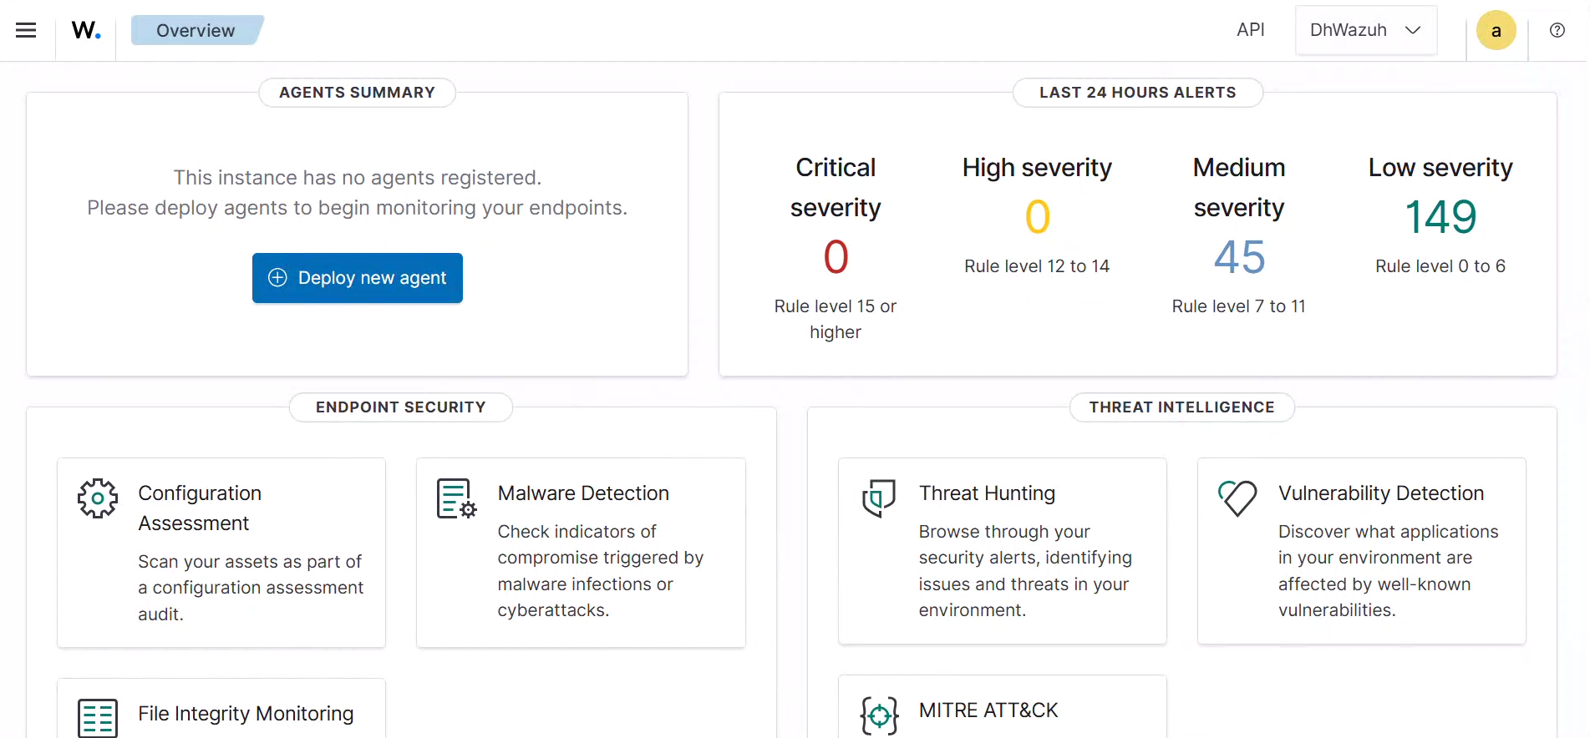
III. Access Wazuh UI
2. Dashboard

Slide 18
IV. Deploy new agent
1. Linux/Ubuntu & Windows
sudo systemctl restart wazuh-agent

Slide 19



